Slide 1
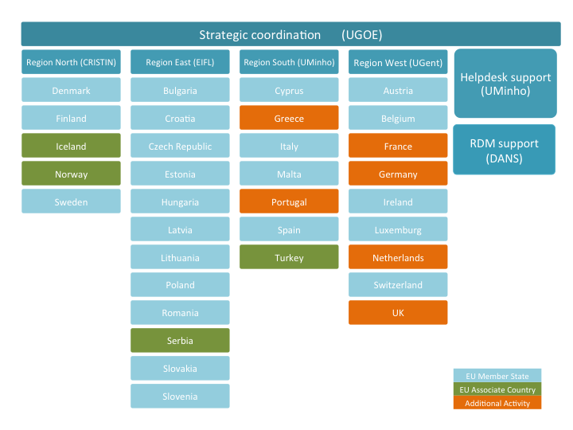
OpenAIRE – Open Access Infrastructure for Research in Europe
People support network
Europe’s diverse landscape requires local support
33 National Open Access Desks all over Europe (NOADs)
(Open Access) policy aligning
Technical assistance
Open Science training and support
Notes:
+ Israel in Advance

